Slide 1
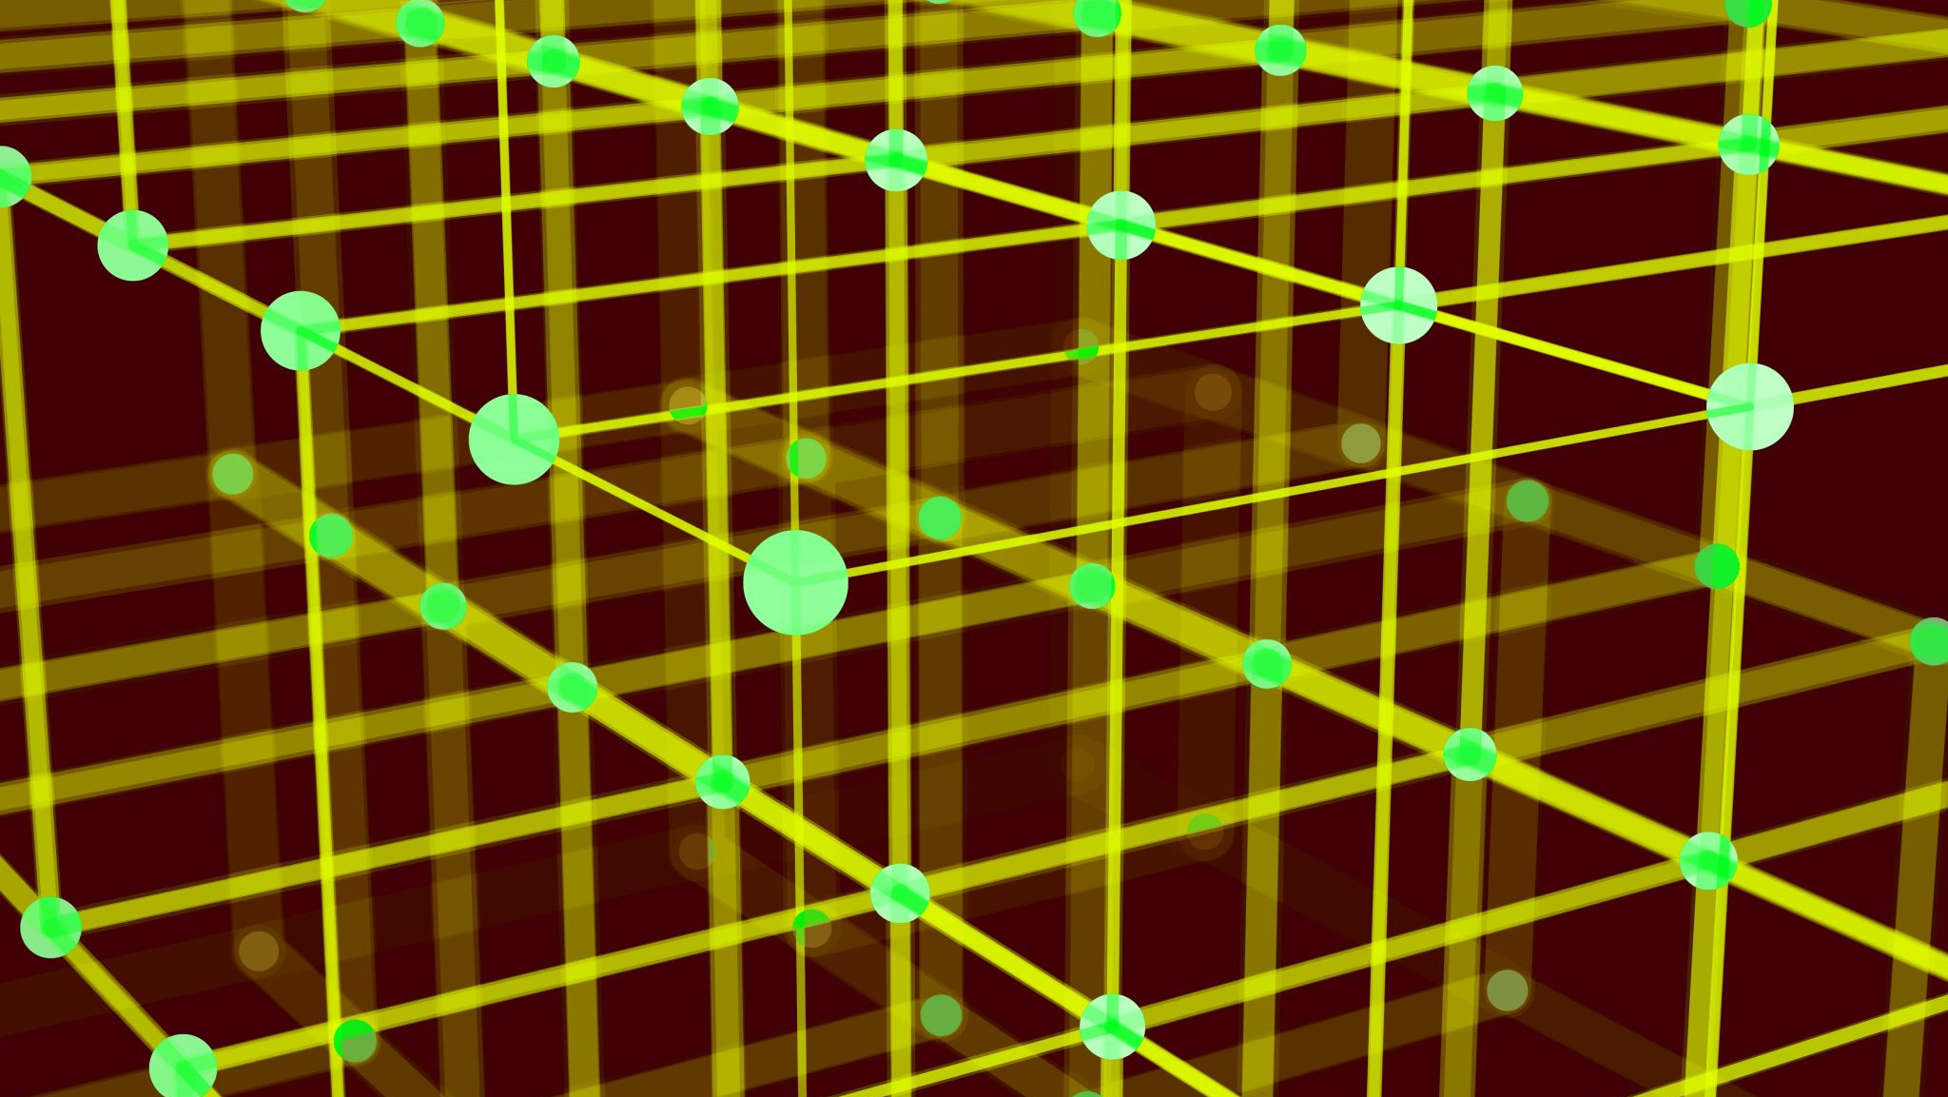
Quantum Computing
Group B

Slide 2
Quantum Logic Basics
Just like the bit is the basic unit of information of a classical computer, a qubit is the basic unit of information of a quantum computer.
A qubit a superposition of binary states 0 and 1, that is, it uses the quantum mechanical phenomena of superposition to achieve a linear combination of two states.
With the use of quantum gates, which are essentially unitary operators (described by unitary matrices), we can build quantum circuits, just like the classical gates are the building blocks of classical circuits.

Slide 3
Simulating Quantum Computers
Simulating a quantum computer to 100% accuracy on a classical computer is naturally impossible as the hardware is just too different.
Our best bet for simulating a quantum process is to use python's numpy module to compute gate transformations and simulate quantum randomness using numpy's own random function.

Slide 4
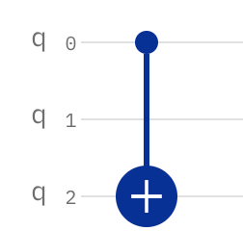
Quantum Gates
For any quantum gate, applying the gate to a register is relatively simple, just multiply by the respective gate matrix, and for any qubit not being acted on by the gate, compute the tensor product with an identity matrix.
The problem arises when you need to do a gate operation on non-adjacent qubits. In this scenario, we simply apply SWAP gates to swap the states of qubits until the states we want are adjacent, apply the correct gate, and then swap all the states back again using SWAP gates.

Slide 5
Measurement
In order to get any actual results from the qubit register we have to measure it. Obviously, we can't replicate the exact method that quantum computers use for measurements, so we need to simulate it in a different way.
Given that the state vector register is a probability distribution, we can generate some random number r between 0 and 1 and increment a count variable by |ψ|^2 for each component in the vector.

Slide 6
Error Simulation

Slide 7
Projects
We implemented two different quantum computing projects
Project 1: Applying Grover's Adaptive Search algorithm to an exoplanet database
Project 2: Breaking RSA encryption using Shor’s Algorithm

Slide 8
Project 1: Grover’s Search Algorithm
Grover’s Algorithm is a quantum search algorithm for searching through an unsorted database. It can find the target in time O(√N), as opposed to classical search algorithms that will find an element in O(N) time.
(e.g. ~32 iterations as opposed to 1000)

Slide 9
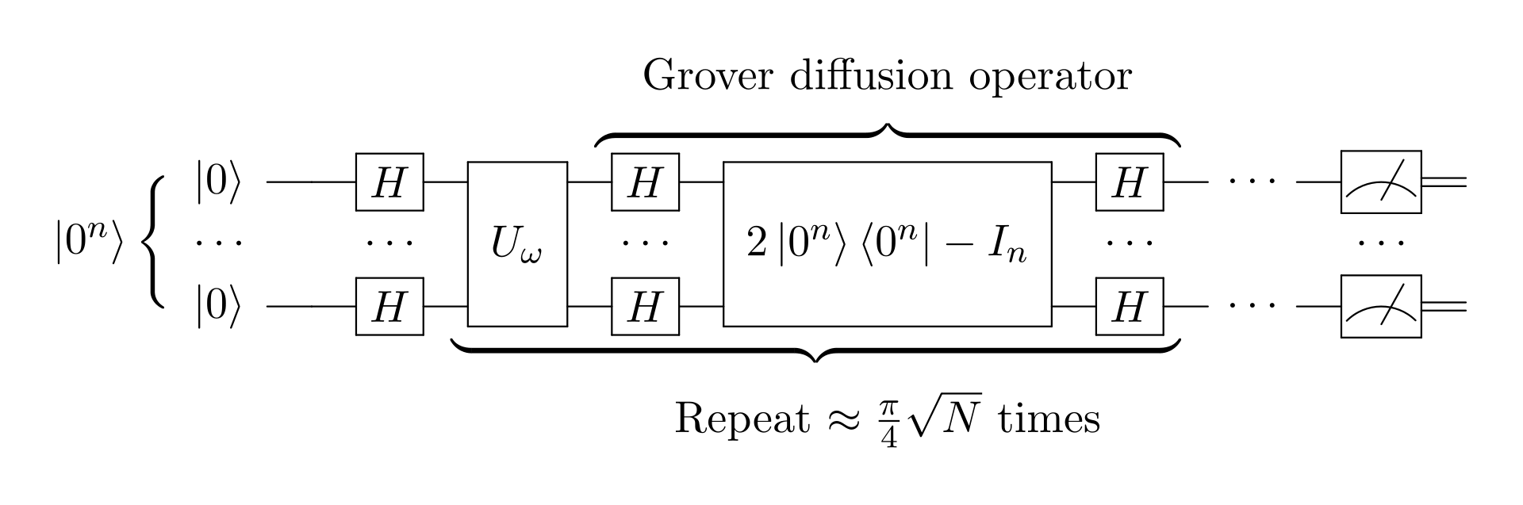

Slide 10
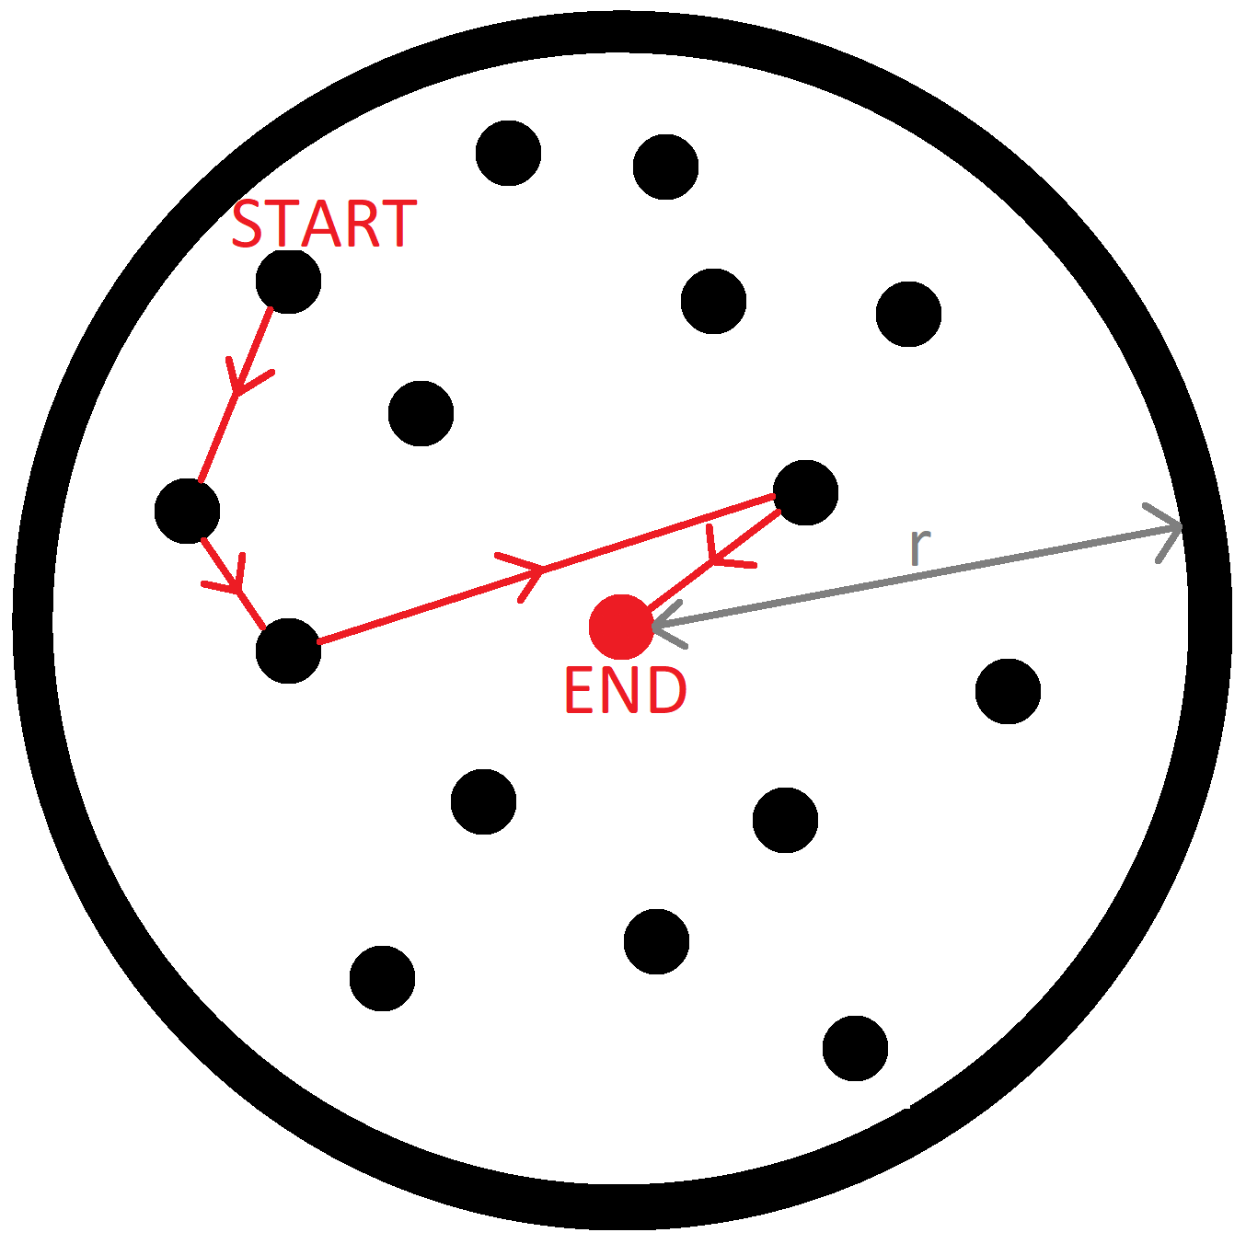
Grover Adaptive Search Algorithm
Grover Adaptive Search (GAS) is an extension of Grover’s Algorithm, which makes use of multiple fast Grover searches to find successively better outputs. GAS is designed to find an input that gives an output within some optimal range.
There are various approaches to GAS, we use the "Durr-Hoyer Algorithm."

Slide 11
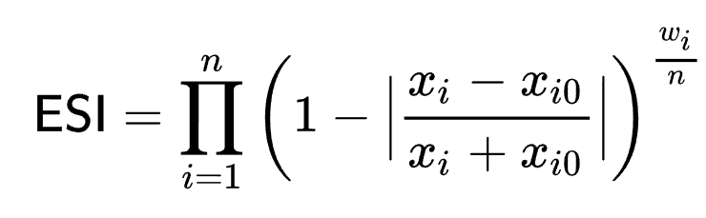
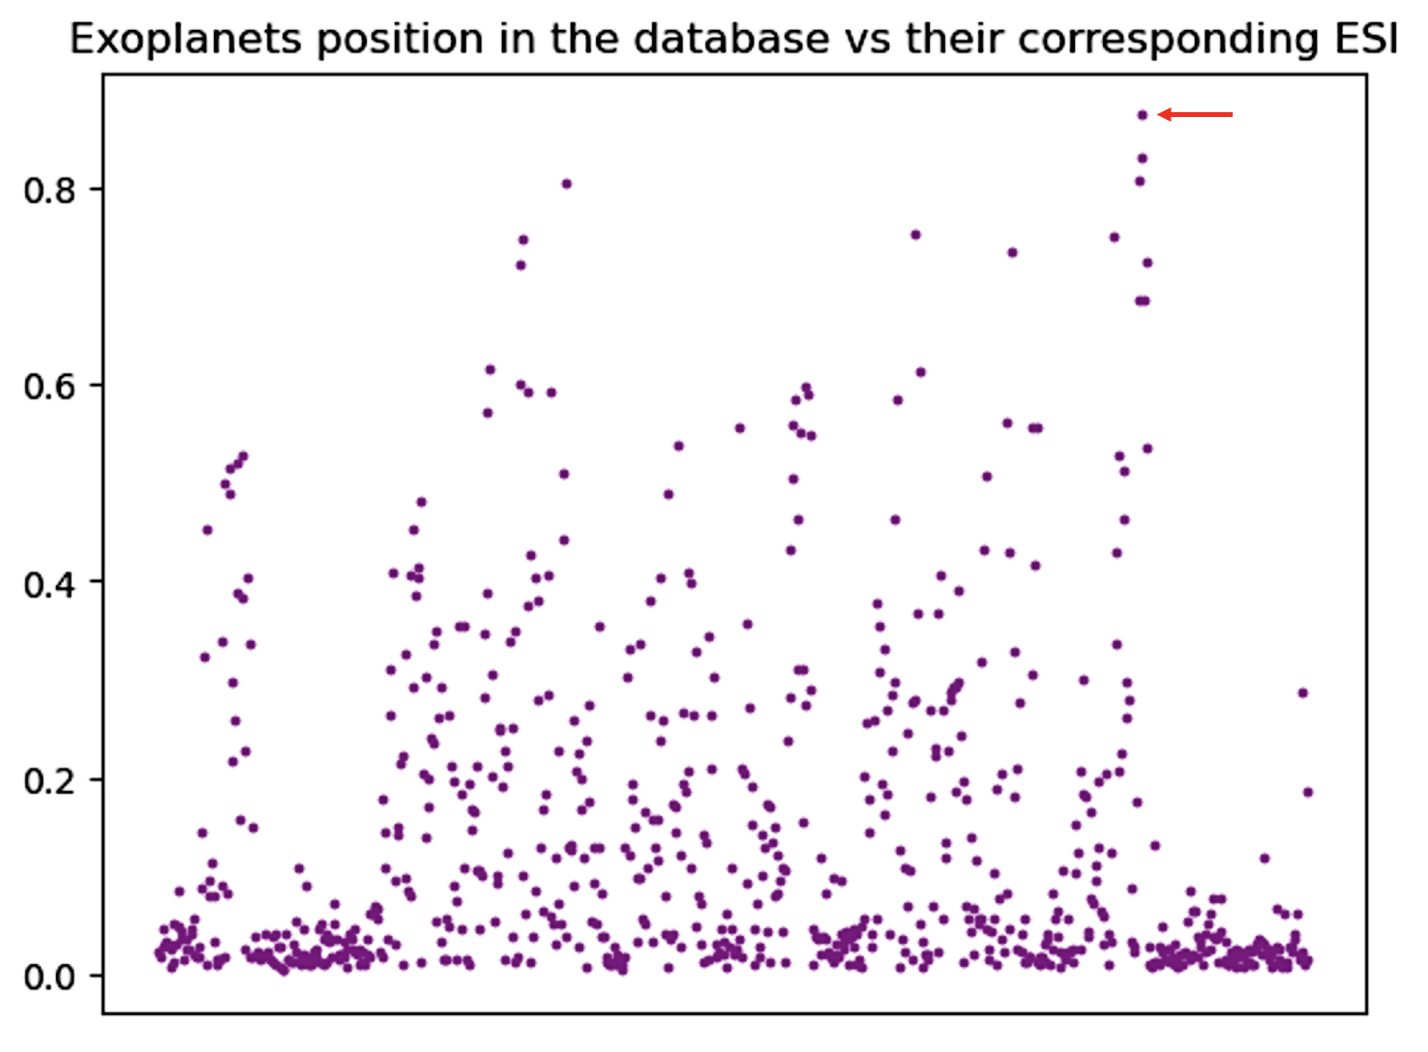
Scanning for habitable planets
We used Grover’s Adaptive Search to search through a database for the "most habitable" planet. Using the Earth Similarity Index (ESI) and the Extrasolar Planets Encyclopedia we computed a new database with 745 exoplanets and their corresponding ESI.

Slide 12
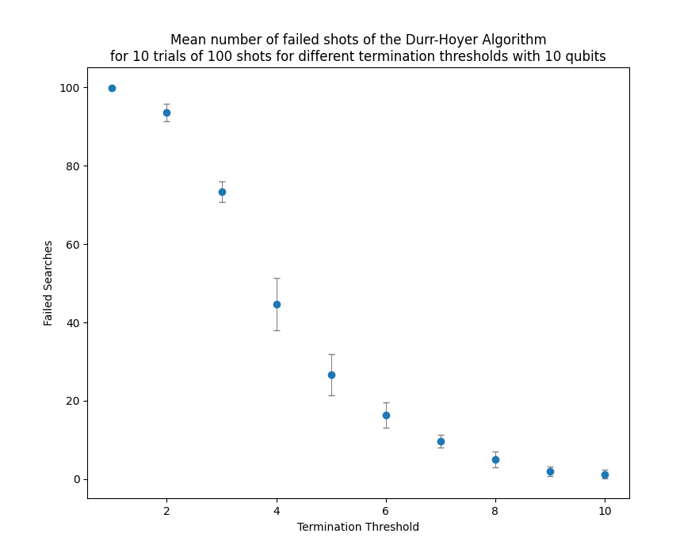
How does GAS find global maximum ESI?
GAS looks for something in a given "optimum region", not necessarily the global maximum.
We will have to modify GAS!
Introduce a "termination threshold" condition. If we fail to find a better datapoint after a certain number µ of GAS loops, we say this is probably the maximum.
Searching through ESI database requires 10 qubits. Training on a randomised 10 qubit database revealed µ=9 is best choice if we tolerate a maximum 5% fail rate.

Slide 13
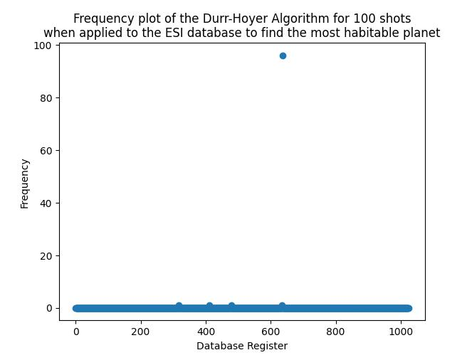
Results:
GAS found the element at register x=636 96% of the time after 100 shots! This corresponded to TRAPPIST 1d with an ESI of 0.873098, which was the correct result. 96% success is within our tolerance of 5% failure.

Slide 14
Further Tests
We then tested GAS to search for finding multiple elements in an optimal region instead of global maximum.
Used a randomly generated database of integers with elements having a value between 1 and 800. However, the first element was always set to 801 to give a well-defined global maximum.
GAS was then used to search for elements above a certain minimum value.

Slide 15
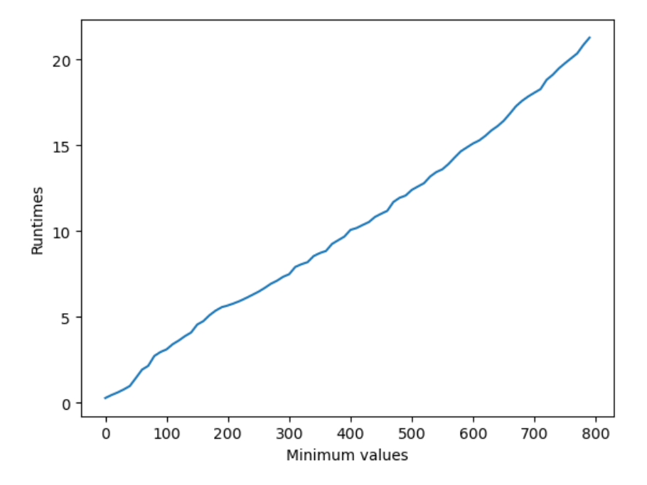
GAS – Range of Values
An increase in the minimum value led to a roughly linear increase in runtime for GAS.
An increase in minimum value corresponds to a decrease in the size of the optimal region.
Therefore (simulated) GAS runtime is inversely proportional to the size of the target region.

Slide 16
Error Simulation – Grover Search

Slide 17
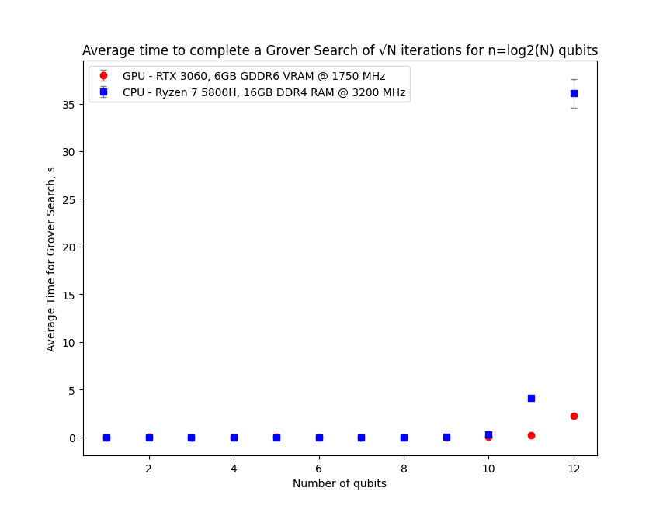
Hardware Acceleration
This is slow! We didn't focus too much on runtime as that is very dependent on the machine our code runs on, but generally these computations involve a lot of linear algebra on enormous matrices.
GPUs are optimised to do such matrix calculations!
We reimplemented our code on a GPU using the CuPy and NVIDIA CUDA libraries.
GPU is exponentially quicker, but this speedup is only noticeable around 9-10 qubits. RAM limits mean we're still limited to 13-14 qubits.

Slide 18
Project 2: Shor's Algorithm and RSA encryption
RSA is a widely used encryption algorithm for data transmission. The algorithm encodes some given message using the product of two large prime numbers and sends this value across a network. The security of this algorithm hinges on the fact that is extremely difficult to find prime factors of a number that large. Shor's algorithm can bypass this limitation by finding prime factors of extremely large numbers in polynomial time.

Slide 19
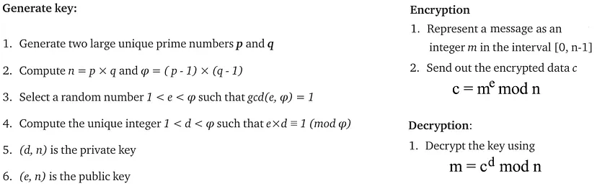
RSA Algorithm
The algorithm works by encrypting Alice's message with the public key, which can be known by everyone. The encrypted message is then sent across a network to Bob, who then decrypts the message with the private key, which only he has access to. Shor's algorithm is so powerful here because it bypasses the need for the private key and can decrypt the message with only the public key.

Slide 20
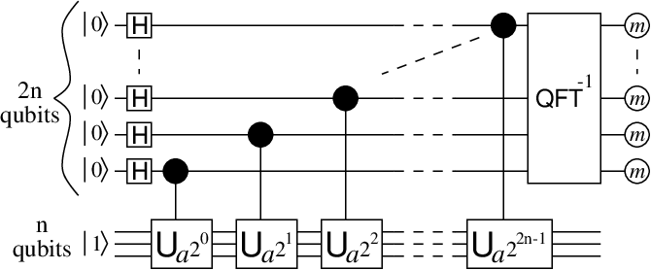
Shor's algorithm
The main quantum part of Shor's algorithm is a period finding circuit, consisting of 2 registers, the main register and the ancillary register. For an n-bit input number N, the ancillary register is n qubits, and the general rule is to then have 2n qubits in the main register.
The U gates in the diagram are modular exponentiation gates and are expressed as permutation matrices generated using a specific algorithm. These gates entangle qubits in the main register with the ancillary register. When the ancillary register is then measured, giving a probability distribution with peaks of separation r.
The Inverse Quantum Fourier Transform is the applied to the main register to yield a distribution with peaks at r or some multiple of r. Continued fractions are used to find the period r, and the factors can be found with gcd(a^r/2 ± 1,N).

Slide 21
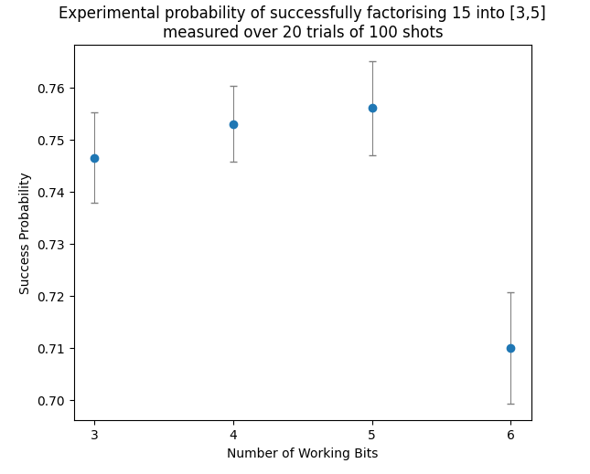
Testing Shor's
Despite the general rule being to have 2n qubits in the main register, this rule is not particularly strict, and we can just use any number of qubits. Given that our limit for simulated qubits was 13, this means we can factorise a good range of (small) numbers.
Test 1 factorised N=15 (n=4) for main register amounts m = 3,4,5,6
Test 2 factorised N=39 (n=6) for main register amounts m = 3,4,5,6.

Slide 22
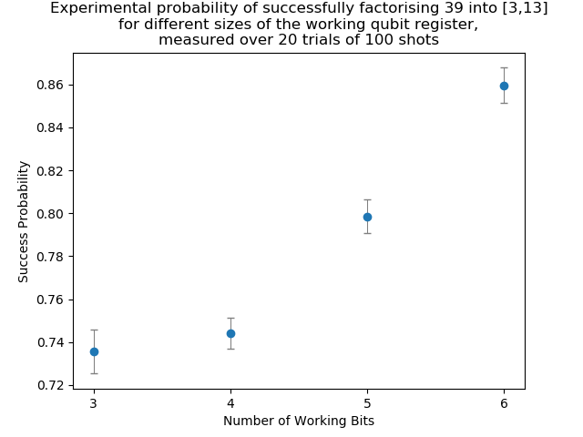
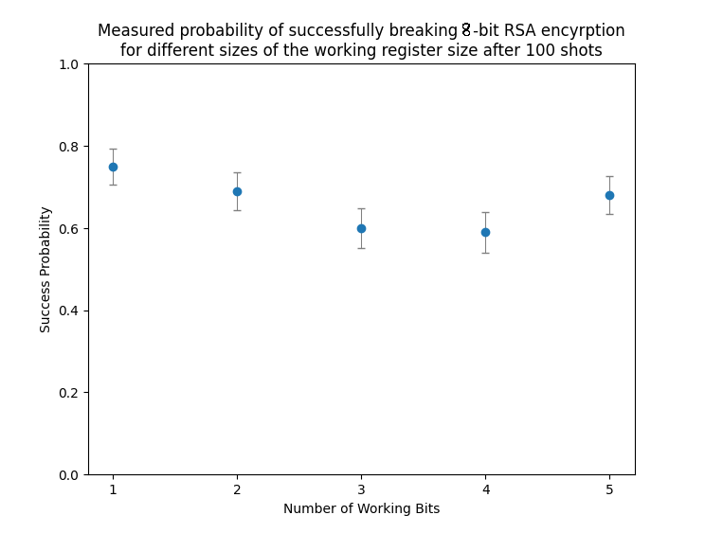
Test Results of Shor's and breaking RSA

Slide 23
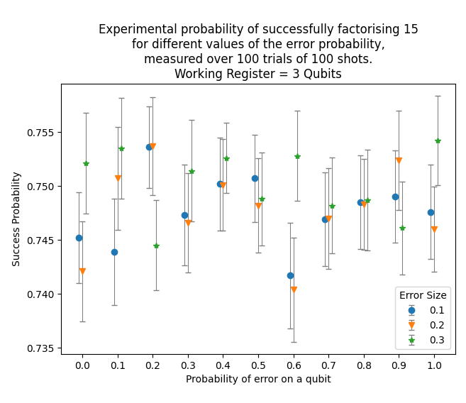
Effect of Quantum Error
Again, error was simulated using randomised SU(2) matrices.
First tested the impact on factorising N=15.
Here we have a working register of L=3 qubits. We also tested L=4 qubits and the results were virtually identical.
Overall, error has a very small impact on the outcome of Shor's algorithm here! This is likely due to the small number of possible outputs, we believe it would be much more noticeable for larger numbers.

Slide 24
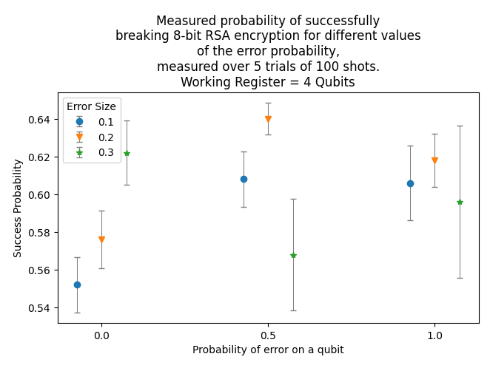
Error and Breaking RSA
We then tested the impact of error on breaking 8-bit RSA for L=3,4 qubits. This is much, much harder to compute and so the sample size was smaller. Again, error seems to have little impact on breaking RSA encryption. Overall the success rate is still low (~55-60%) due to the small working register, which may be obfuscating the results. Overall Shor's algorithm generally seems stable but our ability to test things is really quite limited.

Slide 25
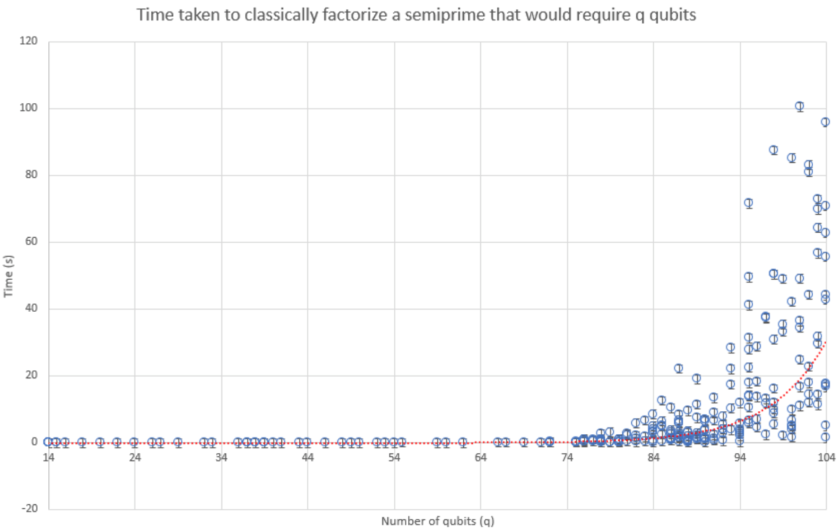
Classical factorization algorithm
Semiprimes were factorised using a classical algorithm which consisted of the classical part of Shor's algorithm with a classical period-finding subroutine.
We produced a graph of algorithm run-time against the minimum number of qubits that would be required for Shor's algorithm to factorise the same semiprime.
This was done to show the exponential nature of classical factorization algorithms – a red dotted exponential line lies over the data points.
However, if a quantum computer was used, the line of best fit would be polynomial.

Slide 26
Shor's and Hardware Limitations
In conclusion, it is technically possible to simulate Shor's algorithm to find prime factors of a number and then use those factors to break RSA encryption with a good probability.
The approach used in this project is not scalable on classical computers however as adding even one qubit over the maximum causes the program to take an unreasonable amount of time to run, meaning we have a hard cap on the size of number we can factorise.
For context, industry-grade RSA is usually 2048 bit and would require 6000-7000 qubits.

Slide 27
Security
We have demonstrated that it is possible to break RSA using Shor's algorithm. Thus, anyone with a large enough quantum computer can break the most secure RSA cryptosystem RSA-4096.
In the future, only quantum-safe cryptosystems such as AES-256 should be used. AES-256 is a symmetric cryptosystem, meaning only one private key between Alice and Bob is used.
Quantum cryptosystems are automatically quantum-safe as a direct result of the "no-cloning theorem" which states that it is impossible to create an identical copy of an unmeasured pure quantum state. Such a cryptosystem is immune to eavesdropping.

